Slide 1
Ankit Kiran Yadav
Email : MailID
LinkedIn : LinkndInProfile
Phone : 8485012806
Shri Guru Gobind Singhji Institute Of Engineering And Technology,Nanded 431606

Slide 2
Arduino Calculator
Calculate some basic Mathematical operations using Arduino and Display using LCD

Slide 3
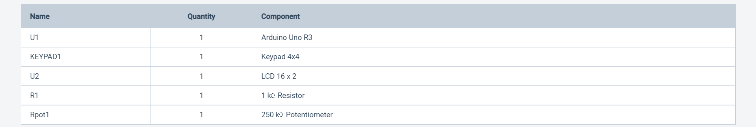
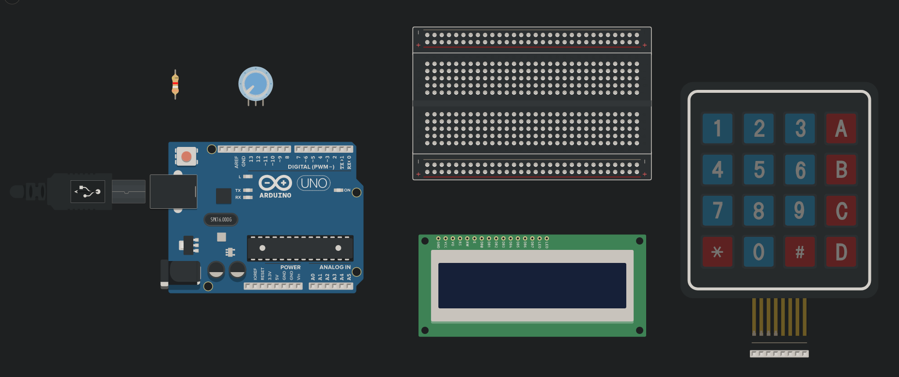
Requirements

Slide 4
Connections
Keypad Connection with Arduino
LCD on Breadboard
Power and Ground to LCD
Potentiometer Connections
Arduino to LCD
Final Circuit
Next Slide

Slide 5
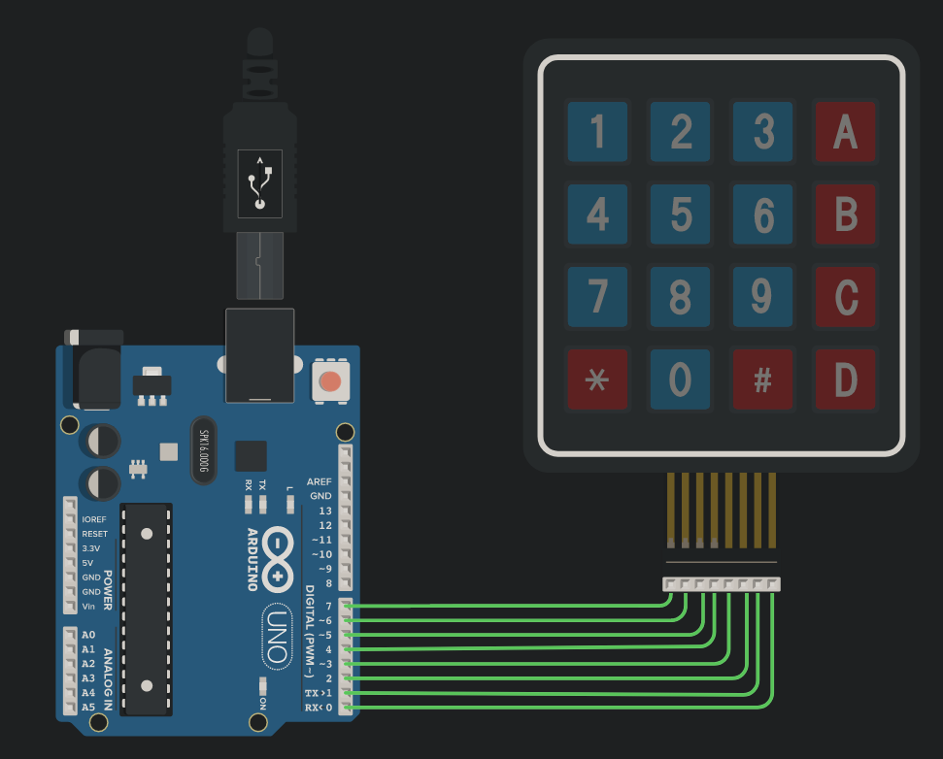
Keypad Connection with Arduino
Connect the 4 row pins on the 4x4 keypad to the Arduino pins 4-7
Connect the 4 column pins on the 4x4 keypad to the Arduino pins 0-3.

Slide 6
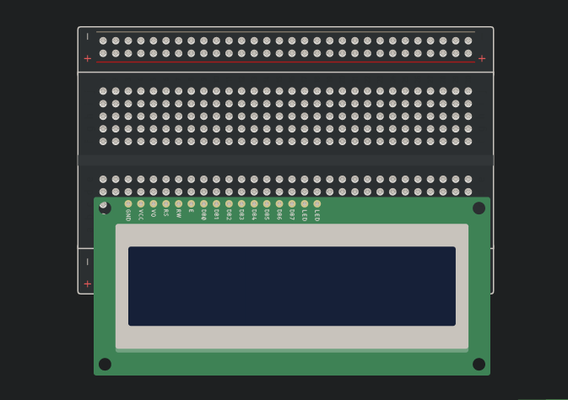
LCD on Breadboard
Place LCD on Breadboard for further connections as all of its pins get connected to the breadboard as shown in attached Image.

Slide 7
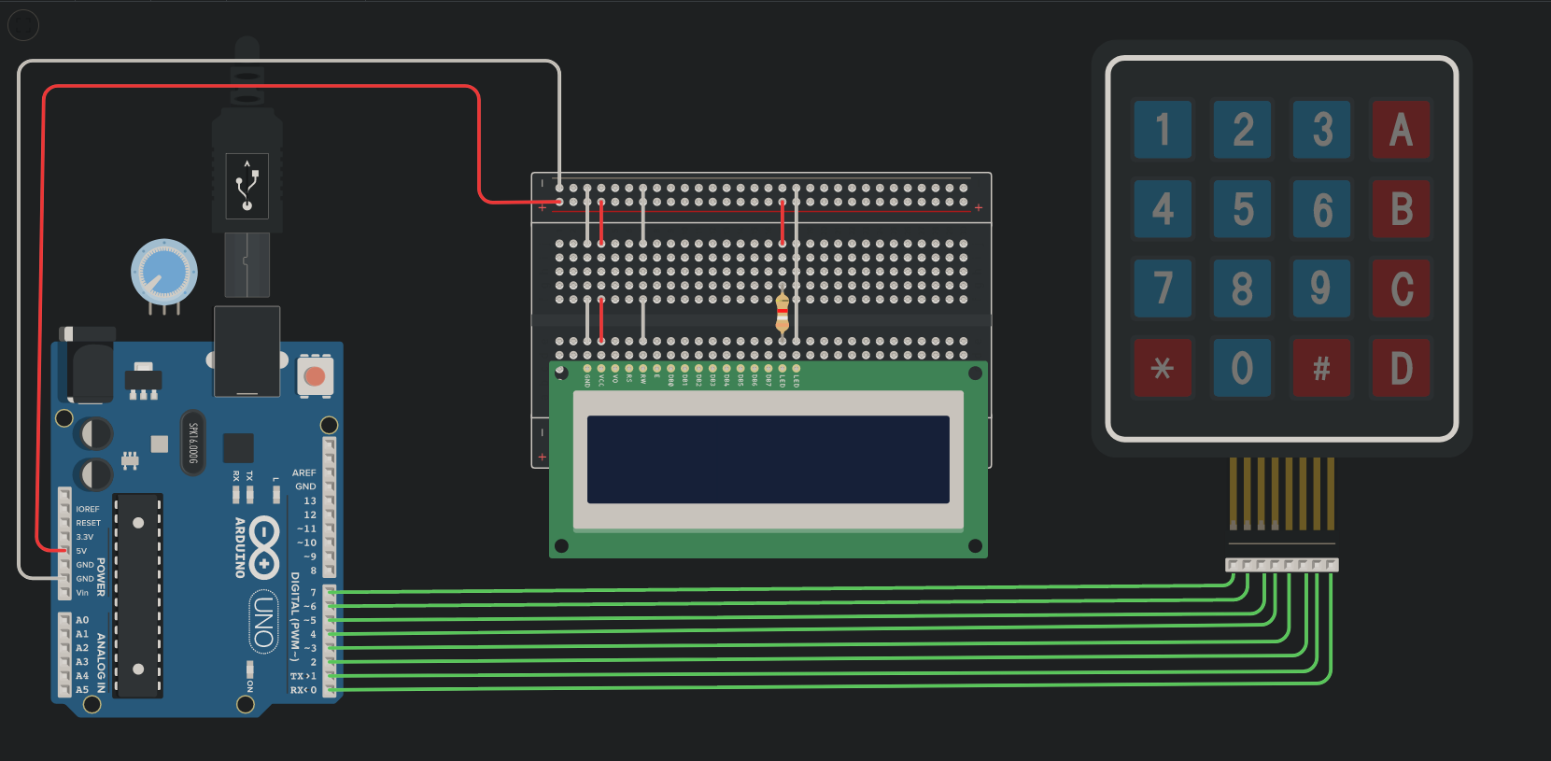
Power and Ground to LCD
Connect the power and ground to the breadboard.
3 Pins of LCD(GND,RW,LED) connect to Ground
VCC of LCD connect to 5V supply i.e. Power
LED of LCD connect with Power with Register (1kilo-ohm)

Slide 8
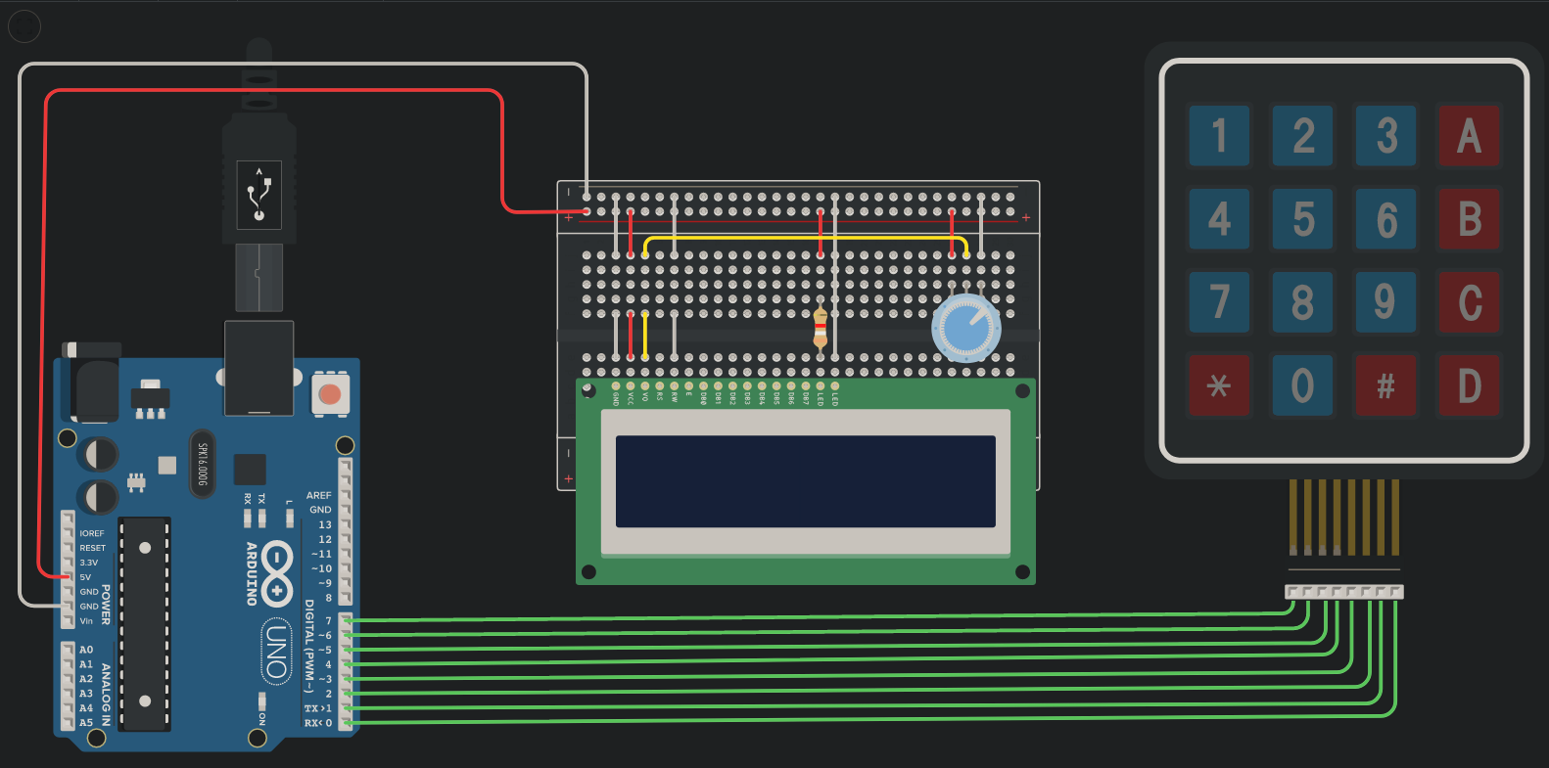
Potentiometer Connections
Connect the potentiometer to the breadboard with 3 free columns
Connect terminal 1 pin to ground
Connect terminal 2 pin to power(5V Supply)
Connect wiper to VO of the LCD.

Slide 9
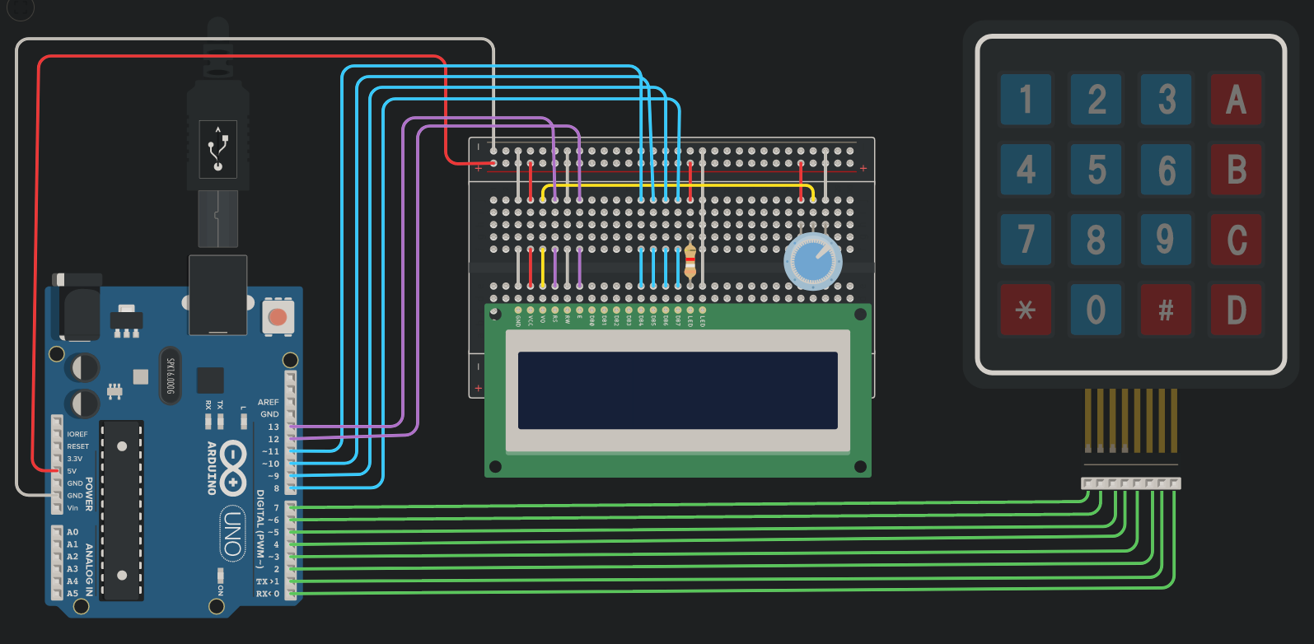
Arduino to LCD
Connect Pins 8-11 on the Arduino to the LCD (DB7-DB4)
Connect pin 12 of the Arduino with the Enable of the LCD i.e. E
Connect pin 13 on the Arduino to the register of the LCD i.e. RS

Slide 10
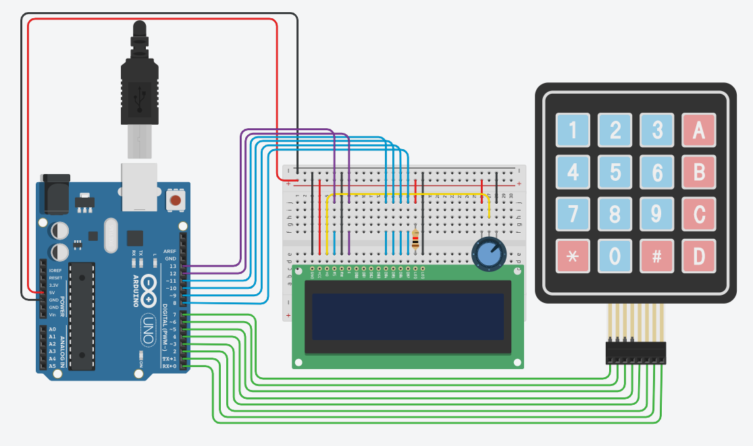
Final Circuit

Slide 11
Code
CodeFile

Slide 12
Results
Addition
Subtraction
Multiplication
Division
Next Slide

Slide 13
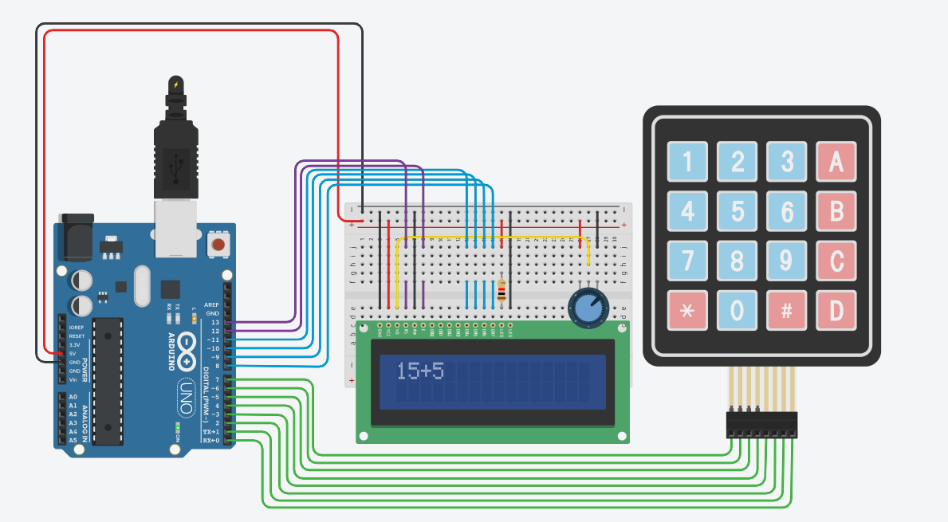
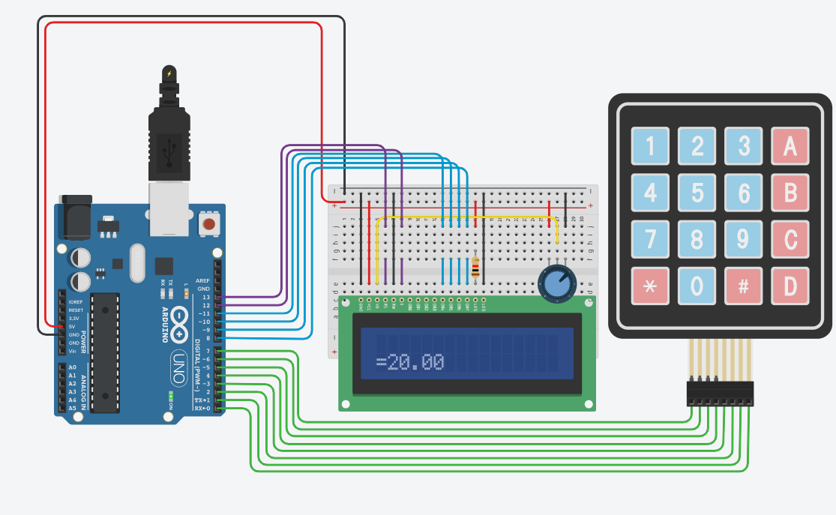
Addition
←Expression
Answer→

Slide 14
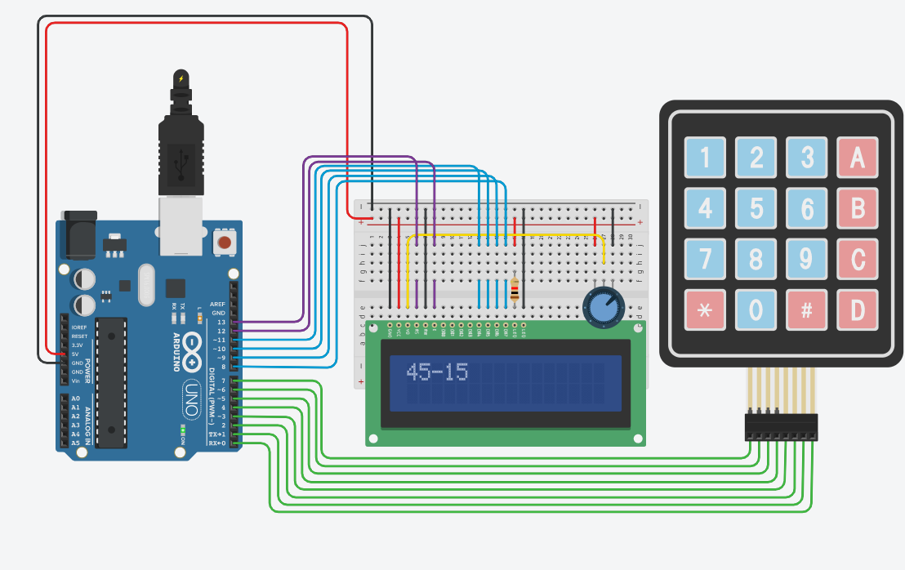
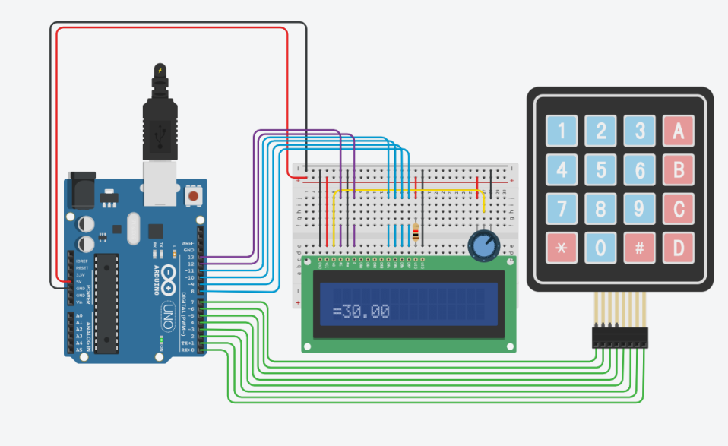
Subtraction
Expression→
←Answer

Slide 15
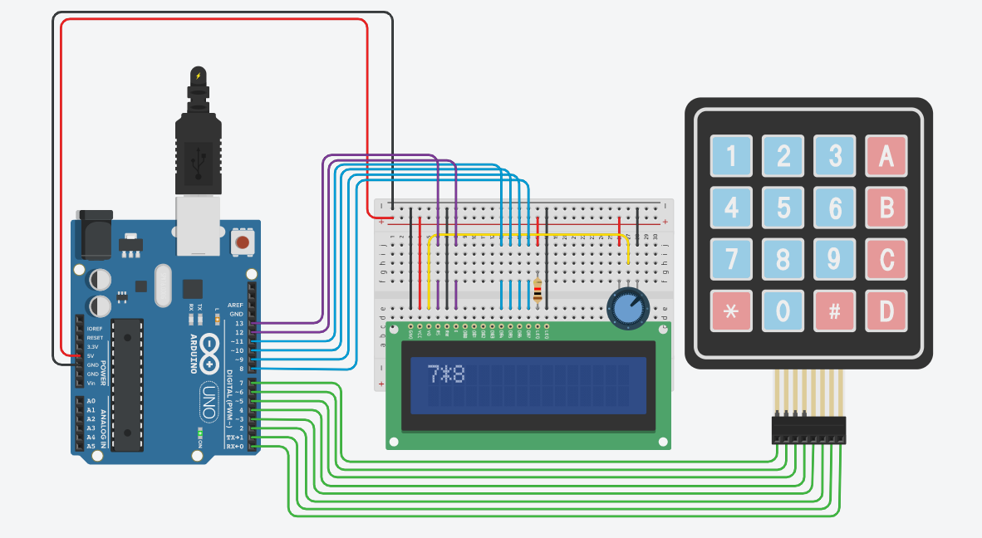
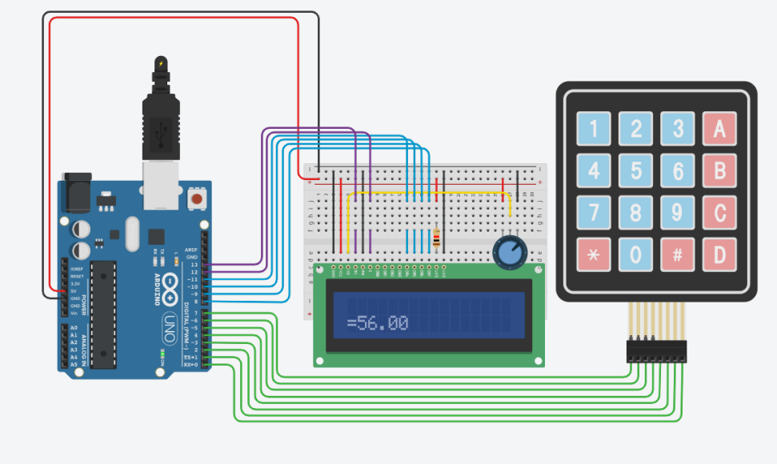
Multiplication
←Expression
Answer→

Slide 16
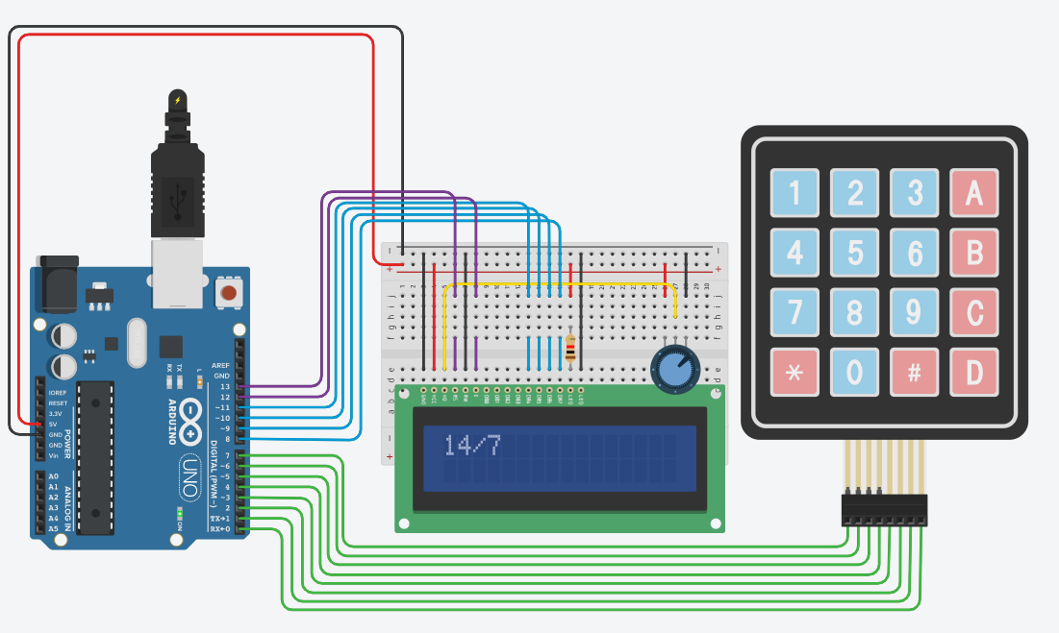
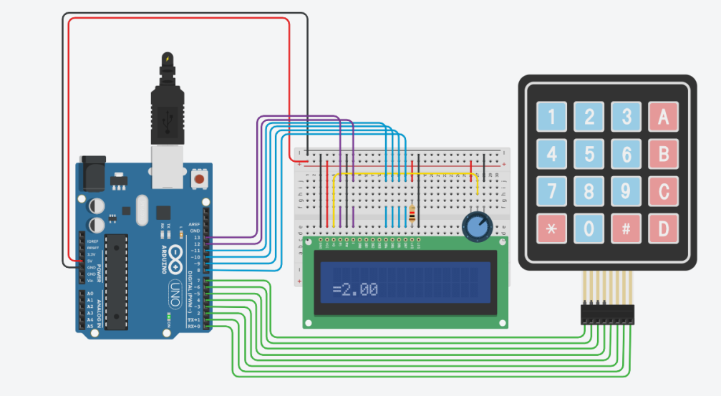
Division
Expression→
←Answer

